Slide 1
Alternative Financing Models How do we mobilize more resources? Joanne Carter, RESULTS

Slide 2
Innovative Finance
What it is –
A way to generate new revenue streams
A way to incentivize or capture more existing development finance for TB and health
What it is not –
A substitute for ODA
A magic bullet

Slide 3
Lancet: Innovative financing instruments for global health
10 IF instruments mobilised US$8.9 billion (2.3% of overall DAH) 2002–15
For GF, these instruments were 2.9% of total. Airline levy raised 67% of total UNITAID funding. For GAVI, it was 36% of total funds;

Slide 4
Criteria for evaluating innovative financing strategies
Additionality
Equity
Do no harm
Impact

Slide 5
Additionality
Must be additional finance, not substitution or excuse for donor withdrawal
Just “sustaining” current levels is failure: everybody needs to do more
Where can it generate new money to add to the pot?
Where can innovation help capture more multilateral bank or other development finance?

Slide 6
Equity
The TB treatment gap is an EQUITY issue
Additional funding should prioritize the hardest to reach
Equity pitfalls:
Pay-for-performance schemes that mis-incentivize
Mechanisms that aren’t designed to fund civil society: community systems and local NGOs

Slide 7
Do No Harm
Don’t skew resources away from the hardest to reach
Don’t impose harmful policies like user fees
Don’t exclude civil society and communities from funding and decision-making
Assess countries’ debt stress and don’t increase unsustainable debt burdens

Slide 8
Impact for Health
Work to ensure concrete and equitable health outcomes
Track if innovative finance schemes have a measurable impact in improving access and outcomes.

Slide 9
Additionality | Equity | Do No Harm | Impact
How do existing models stack up?

Slide 10
UNITAID
Air ticket levy financing; launched in 2006 in 13 countries
UNITAID focuses on HIV, TB, Malaria (plus HepC, HPV, and cross-cutting)
10 years – 59 grants – $2.5 billion

Slide 11
Debt2Health
Agreement to relinquish debt repayments if channeled to the Global Fund
Zero defaults
€100 million in cumulative contributions and another €100 million in the pipeline
2007 to 2018 – €200 million in converted debt

Slide 12
Debt2Health
D2H has converted close to € 200 Million of debt from 2007-2018
Beneficiary countries include:
Indonesia, Pakistan, Cote D’Ivoire,
Ethiopia, Cameroon, DRC
Creditors include: Germany, Australia and Spain
At the recent 2016 Global Fund replenishment, Germany, the Netherlands and Spain announced support for D2H through pledges for 2017-2019
1
Creditor
Debt conversion agreement
Beneficiary
4
Administration and results reporting
2
Counterpart Payment(s)
Global Fund
3
Implementation of health programs
Source: Global Fund

Slide 13
Channeling More IDA to Health
Record $75 billion for IDA 18
World Bank Human Capital Project
44% increase in IDA overall
What could even a proportional increase in IDA heath investment buy?
IDA17 = $4.6 billion for health
IDA 18 = ??? $6.6 billion or more
The question is not whether countries spend their IDA, but what they spend it on.

Slide 14
Global Financing Facility
Increase scale, impact and sustainability of RMNCAH+N
GFF Trust Fund ➔ incentivize increased IDA/domestic investment
Projects approved in 14 countries: US$2.7b in IDA/IBRD financing and US$405m in GFF Trust Fund financing (14 more projects under preparation.)
Ratio of 7:1 IDA/IBRD financing linked to GFF Trust Fund financing

Slide 15
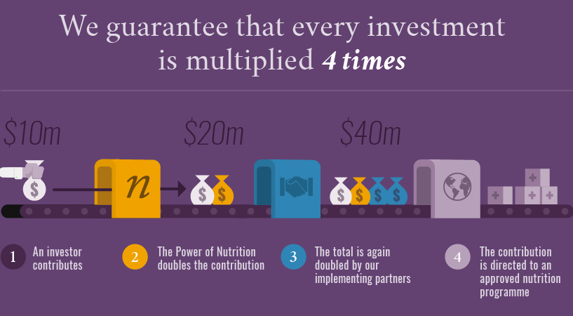
Power of Nutrition

Slide 16
Power of Nutrition
Co-financing enables access to larger levels of resourcing for nutrition impact in high burden countries
Leverages private funding 4-fold via Trust Fund, and then implementer partner matching (World Bank IDA, UNICEF)
$95.4 million committed from PoN Trust
$235.8 million from IDA

Slide 17
Blended Finance: “Buy-Downs”
Blended finance to buy down IBRD or other non-concessional loan to concessional levels for targeted investments
Combines grants and loans
Global Fund estimated average 5:1 leverage, up to 10:1
Examples
Polio
GFF Guatemala
India TB
Potential to create more concessional funding for TB.

Slide 18
Moving forward
Opportunities to achieve scale
Making sure:
Grow total resources
Ensure Equity
Prevent harm
Increase Impact
Need more from every side: being innovative can help us get where we need to be.

Slide 19
Certainly there are things in life that money can’t buy, but it’s very funny – did you ever try buying them without money?
Ogden Nash

